Slide 1

Assessment Frameworks and Dimensions for Educational & Training Resources
Welcome and Goals
Image from Shutterstock

Slide 2

Session Goals
Feed insights from discussion into the Data Management Training Clearinghouse content assessment plan
Identify assessment frameworks that might be adapted/used in DMTC content assessment
Image from Shutterstock

Slide 3

Outline of Today’s Session
Introductions
DMTC Enhancement Project Context - Nancy Hoebelheinrich
Assessment Approaches
Classic Education Approaches – Nancy Hoebelheinrich
Kirkpatrick’s Four Levels – Karl Benedict
CLEAN Network Assessment - Patrick Chandler
DataONE EEVA Tool – Sophie Hou
Group Discussion
Photo Credit: iStockPhoto

Slide 4

Please tell us a bit about yourself
Photo Credit: J J (http://tinyurl.com/ood3en5) - CC:by-nc-nd
Your Name
Affiliation
Interest in this Topic

Slide 5

DMTC Enhancement Project Context
Image from Shutterstock
5

Slide 6

Assessment Approaches
Classic Education Approaches – Nancy Hoebelheinrich
Image from Shutterstock
6

Slide 7
Assessment Approaches
Kirkpatrick’s Four Levels – Karl Benedict
Image from Shutterstock
7

Slide 8
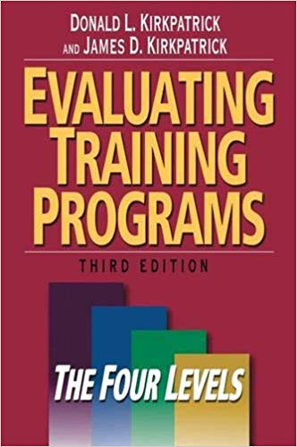
Resource
Donald L. Kirkpatrick and James D. Kirkpatrick. 2006 Evaluating Training Programs: the Four Levels. 3rd Ed. Berrett-Koehler Publishers, Inc.
Original series of articles published in 1959-1960 in the Journal of the American Society of Training Directors.
Later publication: Kirkpatrick, D. L. 1979. Techniques for evaluating training programs. Training and development journal (June 1979): 178–192.

Slide 9
Model
Behavior
Learning
Reaction
Results
The Four Levels provide an intuitive model for conceptualizing a set of training assessment tasks

Slide 10
Model
Learner Reaction to the Training Experience
Key Measures
Subject
Leader
Other Measures
Facility, schedule, materials
Instrument: Survey
Timing: Immediate
Allows for evaluation against a standard and provides information needed to modify/improve training.
Behavior
Learning
Reaction
Results
The Four Levels provide an intuitive model for conceptualizing a set of training assessment tasks

Slide 11
Model
What was learned relative to defined objectives in the training
Key Measures
Knowledge
Skills
Attitudes
Instrument: Test against objective
Timing: Pre- and Post- measurement. Possibly include a control group.
Allows for assessment of improvement in knowledge, skills, and attitudes that can be ascribed to training
Behavior
Learning
Reaction
Results
The Four Levels provide an intuitive model for conceptualizing a set of training assessment tasks

Slide 12
Model
Addresses the question of behavior change in response to learning
Key Measures
Timing
Change
Persistence
Instrument: Interviews of learners and others
Timing: Pre- and repeated Post- measurement. Possibly include a control group.
Challenging to assess.
Behavior
Learning
Reaction
Results
The Four Levels provide an intuitive model for conceptualizing a set of training assessment tasks

Slide 13
Model
Addresses the question of impact of behavior change
Key Measures
Key performance indicators (KPI)
Instrument: Metrics and/or Descriptive Change
Timing: Pre- and Post- measurement. Possibly include a control group.
Selection of KPIs is critical and must be aligned with clearly defined objectives. A clear theory of change is also a component of this assessment.
Behavior
Learning
Reaction
Results
The Four Levels provide an intuitive model for conceptualizing a set of training assessment tasks

Slide 14
Requirements
Behavior
Learning
Reaction
Results
Key Performance Indicators
Target Behaviors
Learning Objectives
Performance Standards
Assessment in each level depends upon the levels below, and defined objectives and measurements relevant to those objectives

Slide 15

Discussion Items
What is our theory of change to achieve desired impacts?
What are the KPIs that are relevant in DMTC content assessment?
How do these translate into target behaviors?
What learning objectives need to be defined to achieve target behaviors?
What is our training focus, and what methods will be most aligned with that focus?

Slide 16
Assessment Approaches
CLEAN Network Assessment – Patrick Chandler
Image from Shutterstock
16

Slide 17
Assessment Approaches
DataONE EEVA Tool – Sophie Hou
Image from Shutterstock
17

Slide 18

Discussion
What are our KPIs, target behaviors, learning objectives, and learning experience standards?
What content should be assessed?
Challenges with a crowdsourced approach?
Strategies and tools?
Image from Shutterstock
18

